Slide 1

Operating Systems
Lecture 43
Syed Mansoor Sarwar

Slide 2
Agenda for Today
Review of the previous lecture
Directory Structures
Links in UNIX/Linux
File System Mounting
File Sharing
File Protection

Slide 3
Review of Lecture 42
Review of the previous lecture
File Concept
File Types
File Operations
Access Methods
Directories
Directory Operations
Directory Structure

Slide 4

Acyclic-Graph Directories
Have shared subdirectories and files.

Slide 5
Acyclic-Graph Directories
Two different names (aliasing)
If dict deletes count ⇒ dangling pointer
Solutions:
  Backpointers, so we can delete all pointers
  Link count solution

Slide 6

General Graph Directory

Slide 7
General Graph Directory
How do we guarantee no cycles?
  Allow only links to files not subdirectories
  Every time a new link is added use a cycle detection algorithm to determine whether it is OK
  Garbage collection

Slide 8
Links in UNIX
Two types of links:
  Hard links
  Soft (symbolic) links
The ln command
  ln [options] existing-file new-file
  ln [options] existing-file-list directory
Examples:
  ln -/prog1.c ~/courses/OS/programs/prog1_hard.c
  ln –s ~/courses/OS/programs/prog2.c ~/prog2_soft.c

Slide 9
Hard Links
~
prog1.c | 12345
courses
OS
programs
prog1_hard.c | 12345

Slide 10
Soft Links
~
prog2_soft.c | 98765
courses
Contents of prog2_soft.c
~/courses/OS/programs/prog2.c
OS
programs
prog2.c | 45678

Slide 11
Links in UNIX
Hard links
  A directory entry for the existing file is created—there is still only one file
  Both entries have the same inode number
  Link count is incremented by one in the inode for the file
  No hard links to directories
  No hard links across file systems
  File is removed from the file system only if its hard link count is 0

Slide 12
Links in UNIX
Soft (symbolic) links
  A file of type ‘link’ is created, which contains the pathname for the existing file as specified in the ln command
  The existing file and the new (link) files have different inode numbers
  When the existing file is removed, you have a ‘dangling pointer’ to it in the link file
  May have soft links to directories
  May have soft links across file systems

Slide 13
File System Mounting
A file system is best visualized as a tree, rooted at /. /dev, /etc, /usr, and other directories in the root directory are branches, which may have their own branches, such as /etc/passwd, /usr/local, and /usr/bin.

Slide 14
File System Mounting
Filling up the root file system is not a good idea, so splitting /var from / is a good idea.
Another common reason to contain certain directory trees on other file systems is if they are to be housed on separate physical disks, or are separate virtual disks, or CDROM drives.

Slide 15
File System Mounting
Mounting makes file systems, files, directories, devices, and special files available for use at a particular location
Mount point is the actual location from which the file system is mounted and accessed.

Slide 16
File System Mounting
You can mount a file or directory if you have access to the file or directory being mounted and write permission for the mount point
Types of mounts:
  Remote mount
  Local mount

Slide 17
File System Mounting
Remote mounts are done on a remote system on which data is transmitted over a telecommunication line
Local mounts are mounts done on your local system

Slide 18
Mounting in UNIX
All files accessible in a Unix system are arranged in one big tree, the file hierarchy, rooted at /. These files can be spread out over several devices.
The mount command serves to attach the file system found on some device to the big file tree. Conversely, the umount command will detach it again.

Slide 19
Mounting in UNIX
mount -t type device dir
Tells the kernel to attach the file system found on device (which is of type type) at the directory dir
The previous contents (if any) and owner and mode of dir become invisible
As long as this file system remains mounted, the pathname dir refers to the root of the file system on device.

Slide 20
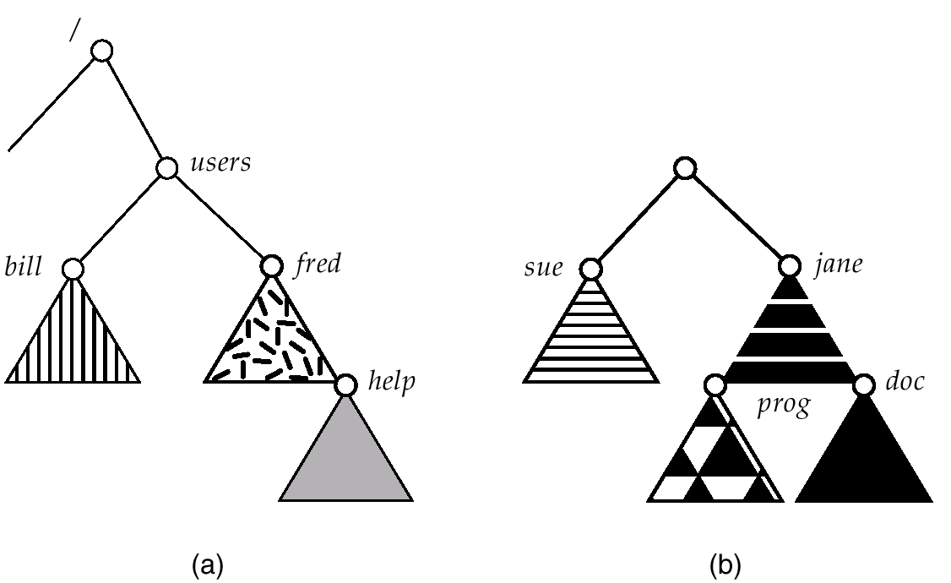
Mounting in UNIX
Existing Tree
Unmounted Filesystem

Slide 21
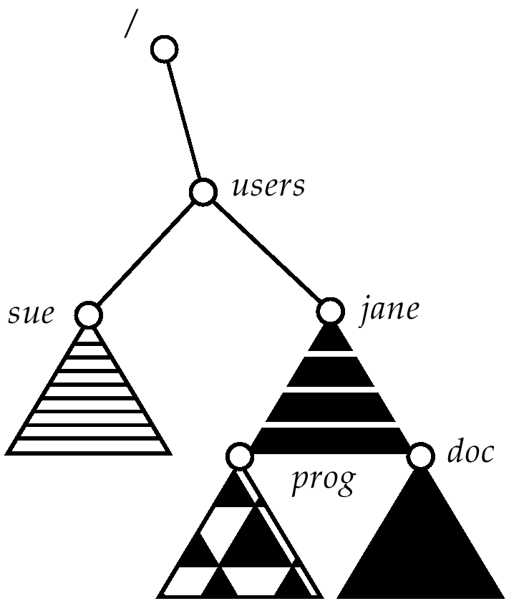
Mounting in UNIX
New Tree after Mounting Filesystem

Slide 22
File System Space Usage
On SuSE Linux
$ df
Filesystem 1K-blocks Used Available Use% Mounted on
/dev/hda3 74837584 11127072 59908892 16% /
tmpfs 257948 12 257936 1% /dev/shm
/dev/hda1 19976 6960 11985 37% /boot
inbox:/var/spool/mail
66602516 3319996 59899232 6% /var/spool/mail
upfile1a:/usr1.a 230044816 70533680 147825456 33% /usr1.a
upfile2a:/usr2.a 230044816 118228296 100130840 55% /usr2.a
upibma:/usr3.a 16713676 804252 15039103 6% /usr3.a
upfile4a:/usr4.a 230044816 14594384 203764752 7% /usr4.a
$

Slide 23
File System Space Usage
On Solaris 2
$ df -v
Mount Dir Filesystem blocks used free %used
/ /dev/dsk/c0t12d 7557677 2484225 4997876 34%
/proc /proc 0 0 0 0%
/etc/mntta mnttab 0 0 0 0%
/dev/fd fd 0 0 0 0%
/var/run swap 510103 22 510081 1%
/tmp swap 683241 173160 510081 26%
/oldexport /dev/dsk/c0t8d0 4668856 4229110 393058 92%
/export/ho /dev/dsk/c0t12d 23684712 21714309 1733556 93%
$

Slide 24
File Sharing
Sharing of files on multi-user systems is desirable.
Sharing may be done through
  Duplicating files
  Common login for members of a team
  Setting appropriate access permissions
  Common groups for members of a team
  Links

Slide 25
Recap of Lecture
Directory Structures
Links in UNIX/Linux
File System Mounting
File Sharing

Slide 26
Operating Systems
Lecture 43
Syed Mansoor Sarwar

